Slide 1



SAP Cloud Platform – Cloud Foundry Training
Training for Ernst & Young – Day 3

Slide 2


DISCLAIMER
The training content and delivery of this presentation is confidential, and cannot be recorded, or copied and distributed to any third party, without the written consent of Imarticus Learning Pvt. Ltd.

Slide 3

AGENDA – DAY 3
Development in Business App Studio
Explain how to start with SAP Business Application Studio
Perform repeat of exercise in last class to BAS
Add DB Connection and Test
Test http services from https file
Explain namespace and aspects
Demonstrate the Custom Exit Codes
Discuss how to debug BAS and hack to code exits
Build UI5 App
Define the basics of SAP UI5
Create Simple SAP UI5 app using BAS Include SAP UI5 index.html with bootstrap
Add launchpad sandbox and app nav Add Component.js and manifest.json
Create index.cds for UI annotations
Connect to CAPM Service
Test Application locally

Slide 4
SAP BUSINESS APPLICATION STUDIO
SAP Business Application Studio is a new SAP Business Technology Platform (BTP) service in SAP Cloud Foundry which offers a modern development environment tailored for efficient development of business applications for the SAP Intelligent Enterprise.
Available as a cloud service, SAP Business Application Studio provides a desktop-like experience similar to leading IDEs, with command line and optimized editors.
At the heart of SAP Business Application Studio are the dev spaces, which are like isolated virtual machines in the cloud containing tailored tools and pre-installed runtimes per business scenario, such as SAP Fiori, SAP S/4HANA extensions, Workflow, Mobile and more.
This simplifies and saves time in setting up your development environment and allows you to efficiently develop, test, build, and run your solution locally or in the cloud.
These tools cover the end-to-end development cycle:Clone an existing project with a Git client or create new project using templates.
Use editors for SAP-specific technologies.
Easily test your application on your dev space while consuming services from remote sources.
Build and deploy the application as a multitarget application (MTA).
Check developer guide here

Slide 5
CREATE DEV SPACE AND WORKSPACE
For the trial environment, SAP Business Application Studio is only available on Amazon Web Services (AWS) - Frankfurt and US East (VA) regions, see Working with Trial.
SAP Business Application Studio for productive accounts is available in AWS and Azure regions.
Choose Create Dev Space.
In SAP Business Application Studio, provide a name for your dev space.
Choose SAP Cloud Business Application as the application type.
By selecting SAP Cloud Business Application, your dev space comes with several extensions out of the box that you need to develop SAP Cloud Business Applications. For example, CDS tools, Java Tools, and MTA Tools are built in. This saves setup time. See Developer Guide for SAP Business Application Studio for more details.
Choose Create Dev Space.
The creation of the dev space takes a while. You see that the status for your dev space changes from STARTING to RUNNING. See Managing Your Dev Spaces for more details.
Once the dev space is running, choose the dev space by clicking on the dev space name.
Set Up Your Dev Space

Slide 6
HANDS-ON PERFORM REPEAT OF EXERCISE IN LAST CLASS TO BAS
Bring all our development to SAP Business Application Studio
Source Code:
https://github.com/soyuztechnologies/capm2/blob/master/

Slide 7
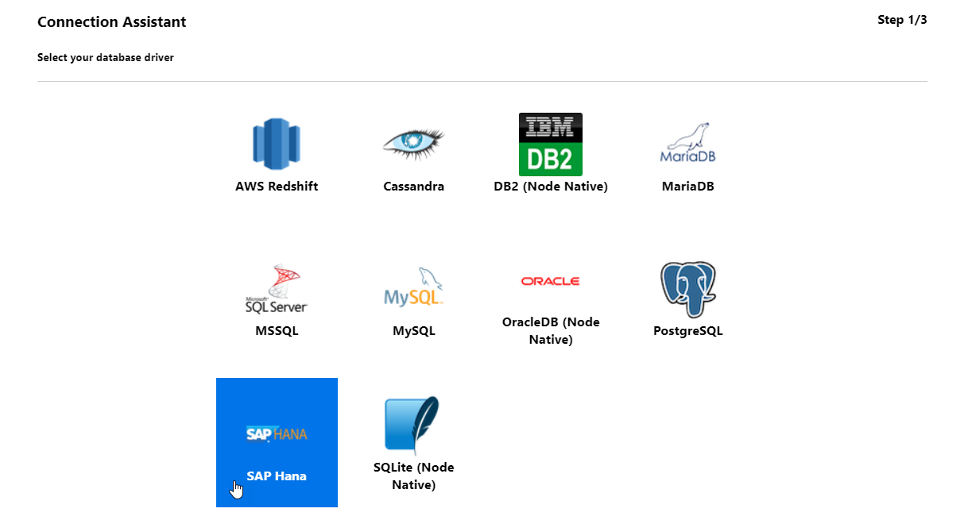
HANDS-ON: ADD DB CONNECTION AND TEST

Slide 8
HANDS-ON: TEST HTTP SERVICES FROM HTTPS FILE
Test our services with a new .http file
Source Code:
https://github.com/soyuztechnologies/capm2/blob/master/srv/query.http

Slide 9
USING ASPECTS FOR SEPARATION OF CONCERNS
Aspects allow you to factor out cross-cutting or technical concerns into separate models/files, potentially with different ownerships and lifecycles. This greatly facilitates keeping core domain models concise and comprehensible.
For example, you could separate concerns into separate files as follows:
schema.cds - your core domain model, kept clean and comprehensible
admin-model.cds - adds additional fields required for maintenance and auditing
auth-model.cds - adds annotations for authorization in a separate file
analytics-model.cds - adds annotations required for analytics use cases
fiori-app.cds - adds annotations required for SAP Fiori Uis
Using Predefined Named Aspects
Instead of extending several definitions repeatedly with the same aspects, you can also predefine named aspects and then easily apply these extensions repeatedly.
Click here for more

Slide 10
HANDS-ON: UNDERSTAND NAMESPACE AND ASPECTS
Create a new Database table artefact by using aspect and UUID.
using { cuid, managed } from '@sap/cds/common’;
entity Demos : cuid, managed{
course: Association to Courses;
no_of_seats: Integer;
booked_seats: Integer;
}

Slide 11
CUSTOM EXIT CODES
Most standard tasks and use cases are covered by generic handlers, so the need to implement event handlers in CAP-based projects, and hence the amount of individual boilerplate coding, is greatly reduced and minified. The remaining cases that need custom handlers are:
Domain-specific programmatic Validations
Augmenting result sets, for example to add computed fields for frontends
Programmatic Authorization Enforcements
Triggering follow-up actions, for example calling other services or emitting outbound events in response to inbound events
And more… In general, all the things not (yet) covered by generic handlers
At runtime, the CAP frameworks usually bootstrap and instantiate service provider instances automatically (→ see also options for project-specific bootstrapping in Node.js and Java). In order to register event handlers with a service provider instance, you first need to associate a respective class or module with a given service definition.

Slide 12
HANDS-ON GENERIC HANDLERS
Add a new CatalogService.js file next to the cds.
const cds = require('@sap/cds')
module.exports = srv => {
console.log(`service name ${srv.name}`);
srv.after('READ','Courses', (records) => {
///console.log(records);
const newRecords = [];
records.forEach(element => {
if(element.method === "Online"){
element.course_name = "[discount]" + element.course_name;
}
newRecords.push(JSON.parse(JSON.stringify(element)));
});
console.log(newRecords);
return newRecords;
});
}

Slide 13
DEBUGGING BAS AND HACKING TO CODE EXITS
You can use debugging capabilities in BAS to check code line by line and explore properties at runtime.

Slide 14

Break

Slide 15
UNDERSTAND BASICS OF SAP UI5
01
SAP UI5 is SAP’s new UI technology. Using this framework we can build web applications which can run on any device, any platform, any browser.
SAP UI5 is a framework
02
A framework is a collection of libraries e.g. sap.m, sap.ui.layout
03
Each library is a collection of Classes e.g. Button, Input, Table, List, Select, CheckBox….
04
Each class is a collection of attributes, methods and events e.g. text, getText(), press

Slide 16
MVC ARCHITECTURE
{what}
Controller
Processing - Logic
Button
View
I/O – what will user see
Model
Data

Slide 17
CLIENT-SERVER ARCHITECTURE
Form submit
HTTPObject Request
Using AJAX
Header + Body(content)
request
Browser
(client)
Server
Java, ABAP, .NET, Python
response
DB
Header.RequestType
GET – Just read data from server
POST – Create new data inside server
PUT – Update data inside server
DELETE – Delete Data inside server
Header + Body(content)
CRUD
Create, Read, Update and Delete

Slide 18
HANDS-ON ADDING FIRST SAP UI5 BOOTSTRAP AND LOADING APP
In this tutorial, we will add an index.html file to bootstrap SAPUI5 and add project path
https://github.com/soyuztechnologies/capm2/blob/master/app/managestudents/webapp/index.html

Slide 19
COMPONENT.JS
An app which has a file named as Component.js is called Fiori Like App. What is the purpose?
Component JS wraps the functionality of the fiori app
It is the starting point of our app
We can integrate Fiori App with Launchpad (central page for all Fiori Apps) only when the app contains Component.js
It contains details about the app like title, description, id, version
All the models, dependencies, reusable JS and CSS, supported devices, themes
Supported SAP UI5 versions
Navigation between views along with View instantiation – Router
ABAP deployment URL
Which OData our app is talking
Other Component is this app dependent
Start of the app happens using component.js

Slide 20
APP STRUCTURE
Index
Test component
Component.js
manifest.json
App.view.xml
Container
Control
App, SplitApp
View 1
View 2

Slide 21
RULES OF COMPONENT.JS AND MANIFEST.JSON
manifest.json is also known as application descriptor file.
Component.js should exist in the root directory of our app. (webapp)
If we wish to have manifest.json, the file also lives in same directory.
The name of the file MUST be Component.js
The file inherits from SAP Standard super-class called sap/ui/core/UIComponent
Will have 3 methods init, createContent, destroy
Baseclass.prototype.method.apply(this);
There is only and only one Component.js file allowed in an app.
Its is a gold standard and best practice for Fiori Apps.
It contains all the information like app name, version, navigation, support, dependencies, views, supported versions, dependencies on another component
Provides central reference for all functionality, so we can check the code of ANY sap standard and custom apps.
It works always with Component JS, and allows SAPUI5 framework to create most of things for you.

Slide 22
HANDS-ON: ADDING COMPONENT.JS AND MANIFEST.JSON
In this section we will add manifest.json and component.js to start our app and check service binding
https://github.com/soyuztechnologies/capm2/tree/master/app/managestudents/webapp

Slide 23
FIORI ANNOTATIONS CONCEPT
SAP Fiori elements provide designs for UI patterns and predefined templates for common application use cases. App developers can use SAP Fiori elements to create SAP Fiori applications based on OData services and annotations that don't need JavaScript UI coding. The resulting app uses predefined views and controllers that are provided centrally.
This means no application-specific view instances are required. The SAPUI5 runtime interprets metadata and annotations of the underlying OData service and uses the corresponding views for the SAP Fiori app at startup.
Why use SAP Fiori elements?
Development efficiency
Design consistency
Decoupling of UI and business logic
High development efficiency to cover what 80% of all apps need
You do not need to build the UI over and over again. Just reuse the common features required by most applications. They are provided by the SAP Fiori elements floorplans.
Predefined floorplans, views, and controllers ensure UI consistency within and across similar apps. Apps created using SAP Fiori elements are kept up-to-date as they are automatically adapted to the most recent design guidelines.
The metadata-driven development model uses semantic annotations and significantly reduces the amount of front-end code. Developers can focus on the business logic
Check Fiori List Report Element here

Slide 24
HANDS-ON CREATE INDEX.CDS FOR UI ANNOTATIONS
Add an index.cds file which annotates the OData metadata with fiori annotations
https://github.com/soyuztechnologies/capm2/blob/master/srv/index.cds

Slide 25
HANDS-ON: TEST AND ADD I18N TEXTS
Test the app and add language support.

Slide 26

Summarize
LET’S SUMMARISE!

Slide 27

Summarize
End of Day 4

Slide 29



We’re committed to empower you to be
#FutureReady
through powerful training solutions.
We build the workforce of the future.
250+
Corporate Clients
30,000+
Learners Trained
25000+
Learners Placed
FREE WEBINARS
Sign up for free webinars with industry experts every fortnight!
Enroll Now!
Contact us today!
https://imarticus.org/

